Slide 1
VISUAL INTELLIGENCE SYSTEM
Deepa Bhandari (140336) Rohan Baidya (140335) Deepak Shah (140328) Punita Kushwaha (140316)

Slide 2
What’s VIS?
A generic system that:
- applies ‘Computer Vision’ - implements task as: 1. Pattern Detection 2. Visual Recognition

Slide 3
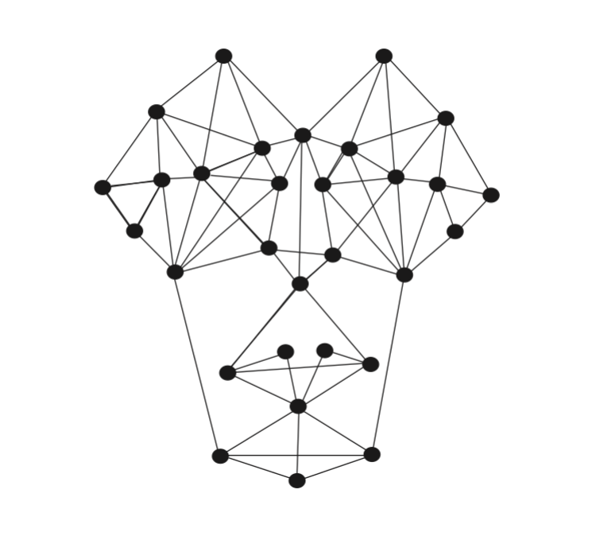
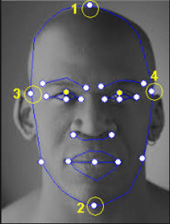
Pattern Detection
identify using the marking of control points taken at a specific level.

Slide 4
Visual Recognition
Technique to identify a target on basis of approximation or matching with:
- Template - Pattern
- Mathematical Function

Slide 5
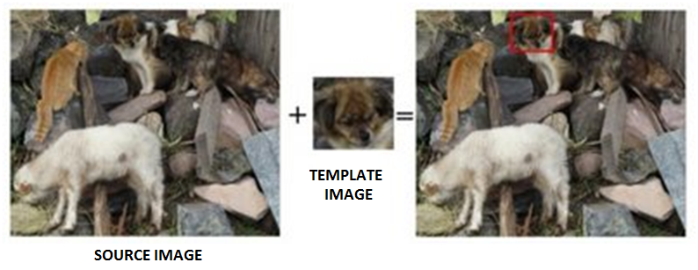
Template Matching
identify areas of source image that match to a template image (patch).

Slide 6
Objective
- To detect relative patch image (Face). - To identify subject on source image.
- To fetch Data referenced by the patch.

Slide 7
Application
Intelligence Network
Deep Learning (Machine Learning)
Autonomous Vehicle
Biological Species Identification

Slide 8


Slide 9
Application
Intelligence Network
Deep Learning (Machine Learning)
Autonomous Vehicle
Biological Species Identification

Slide 10
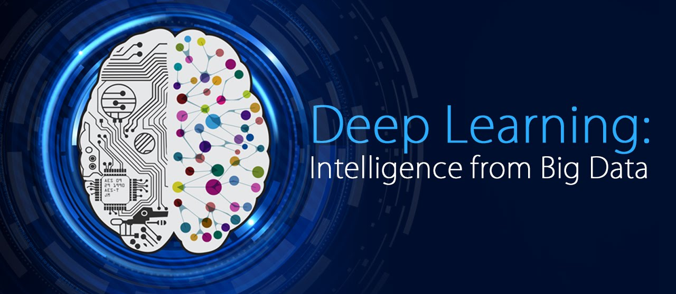
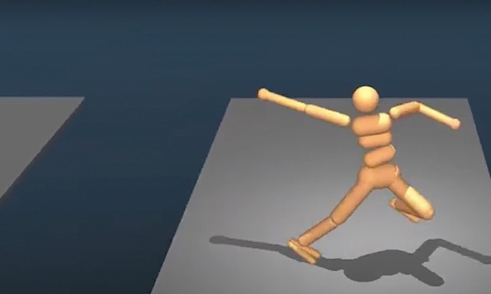
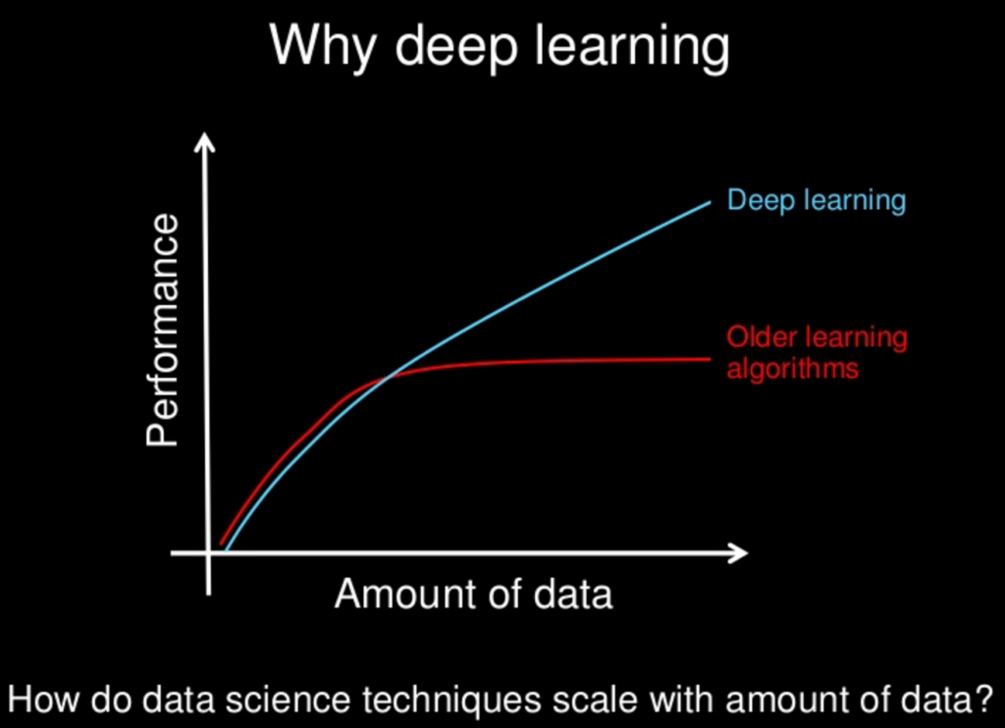


Slide 11
Application
Intelligence Network
Deep Learning (Machine Learning)
Autonomous Vehicle
Biological Species Identification

Slide 12
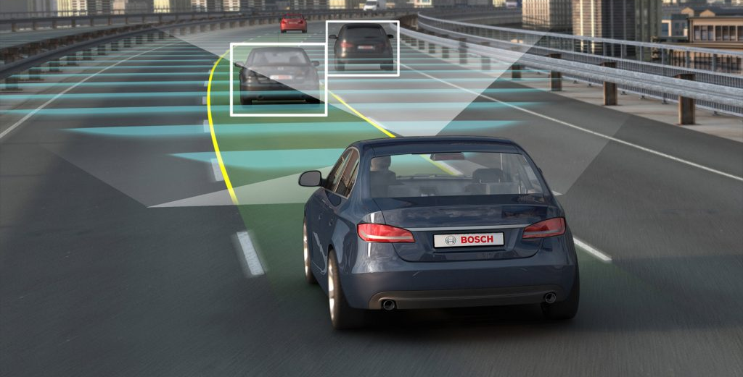
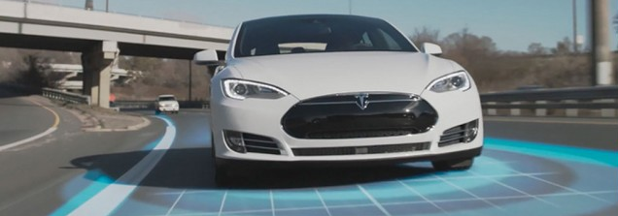

Slide 13
Application
Intelligence Network
Deep Learning (Machine Learning)
Autonomous Vehicle
Biological Species Identification

Slide 14
Tools
Language: Java
Library: Open CV v3.3
IDE: Netbeans – v8.2
Development Kit: JDK – v1.8
User Interface: Swing or AWT

Slide 15

Java
OO HL Programming Language
Developed by James Gosling
Licensed under GPL by Sun Microsys
Cross Platform

Slide 16

Open CV
Open Computer Vision
Cross-platform Library
Real Time Computer Imagery
Developed by Intel in C/ C++
Open Source BSD Licensed

Slide 17
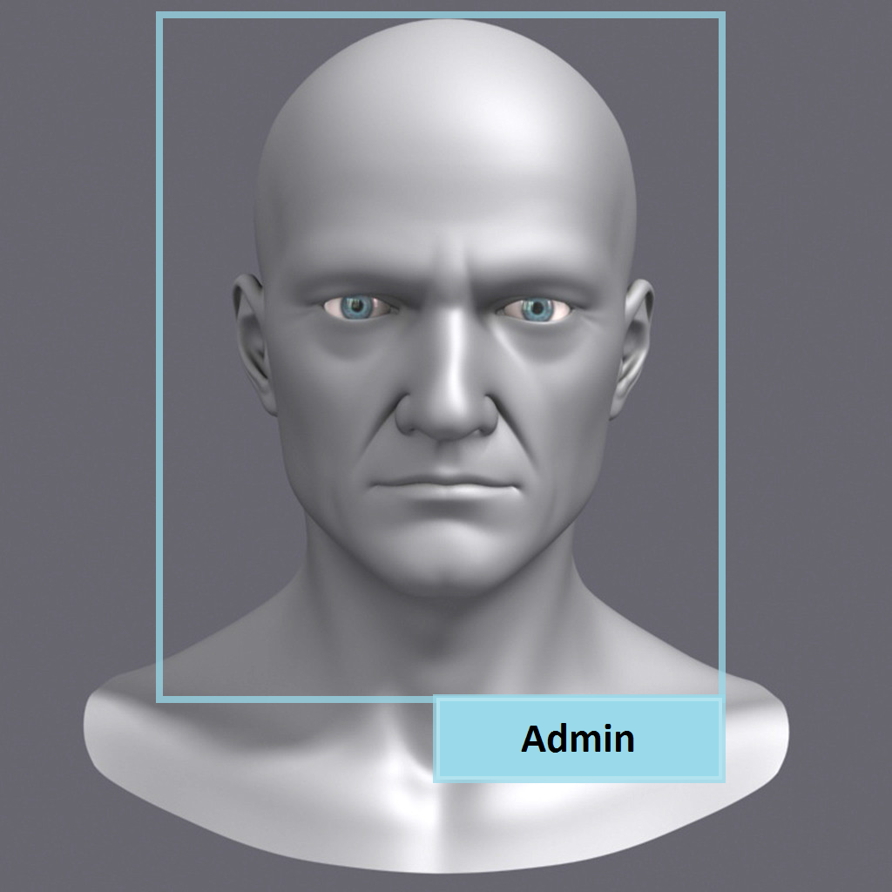
Expected Output

Slide 18
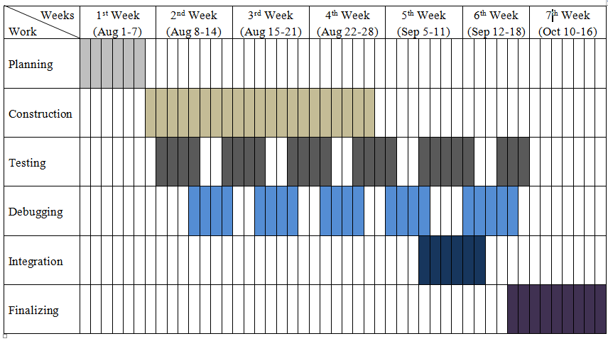
Working Schedule

Slide 19
References:
https://phys.org/news/2016-12-facial-recognition-technology-real-world.html
https://techcrunch.com/2016/11/16/facial-gesture-controls/
http://docs.opencv.org/2.4/doc/tutorials/imgproc/histograms/template_matching/template_matching.html
http://www.audioanalytic.com/3-reasons-why-sound-recognition-is-the-next-big-thing-in-smart-home/

Slide 20
THANK YOU!

